Slide 1

Client Relationship Manager
Software Engineering Major Project

Slide 2
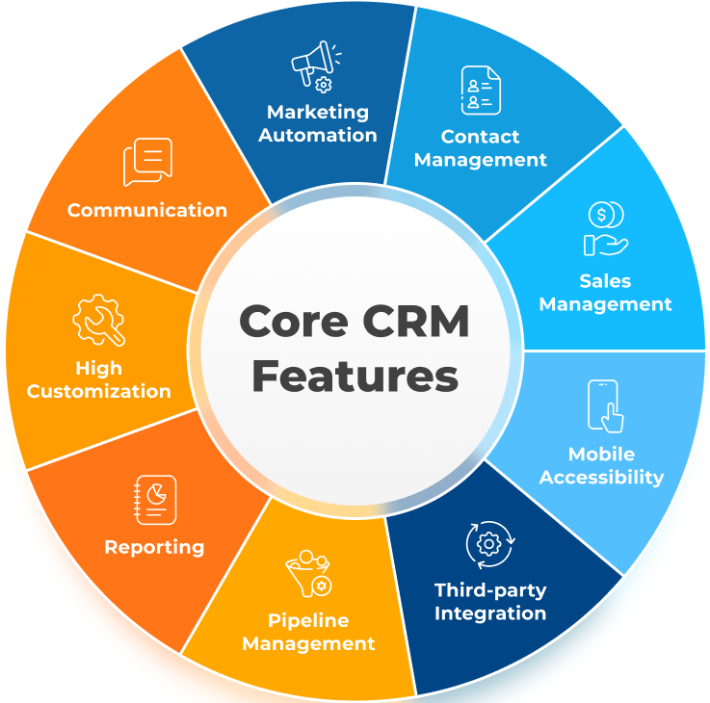
What is a CRM?
Notes:
What is a CRM
Customer Relationship Management
Helps businesses manage interactions
Track Companies: Invoice, Quotes, Leads

Slide 3
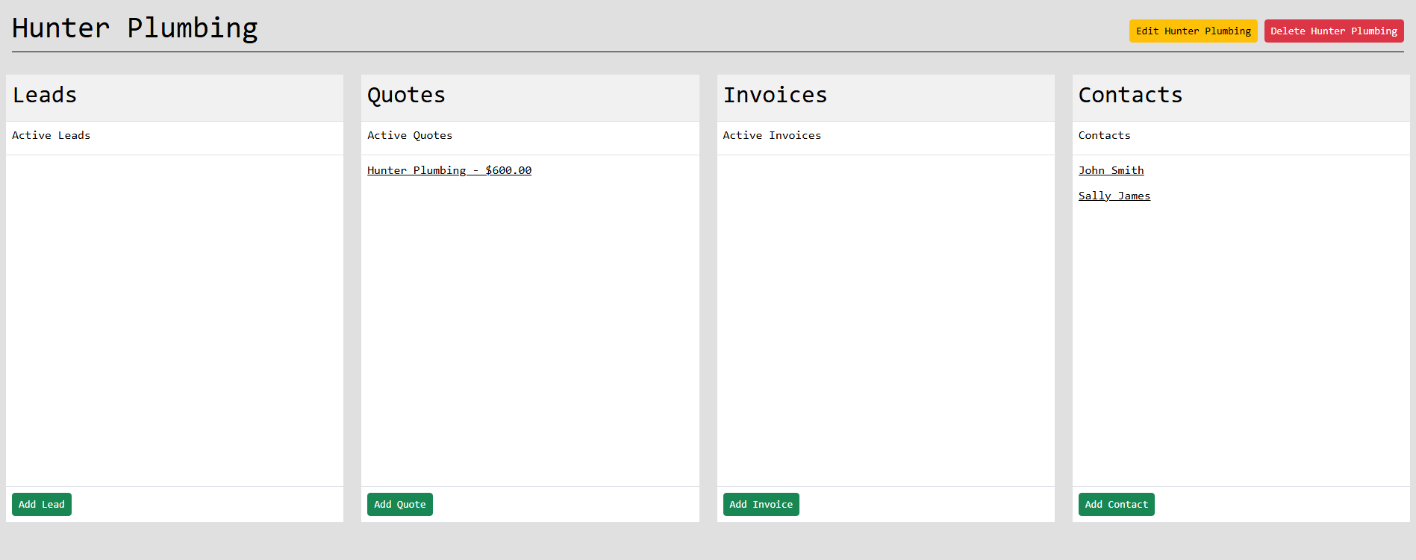
What’s the need for a CRM?
Notes:
What’s the need for a CRM?
Allows business to track their quote, leads, invoices
Organises the businesses interactions
Keeps a record of all companies, contacts and existing leads, quotes and invoices

Slide 4
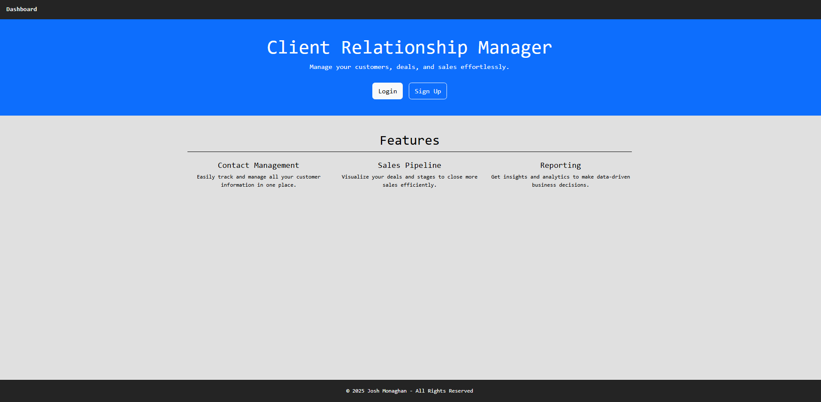
Requirements and Expectations for the project
Notes:
Requirements for the project:
All pages must load in 3 seconds on an average internet speed
All pages must have links to navigate to another page
Users must only see their own data
Reports must not take longer then 5 seconds to generate

Slide 5
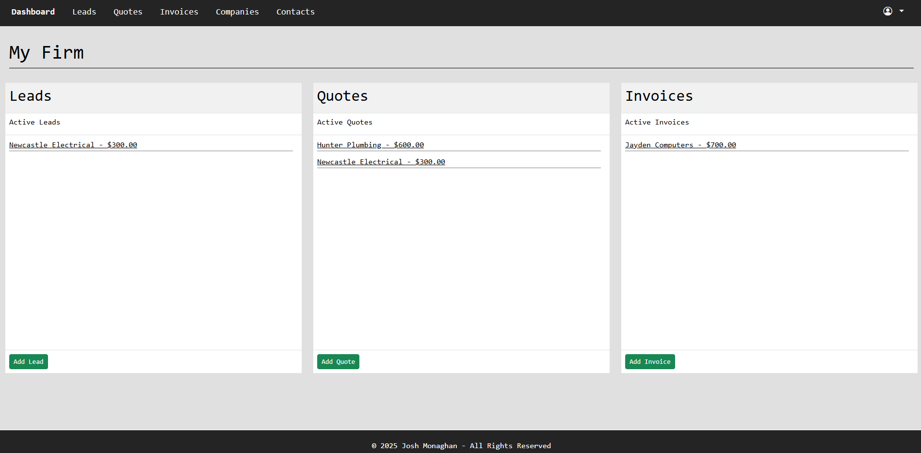
What are features of my CRM?
Notes:
What are features of my CRM?
Features:
User Login and Signup
Leads
Quotes
Invoices
Companies
Contacts
Reporting

Slide 6
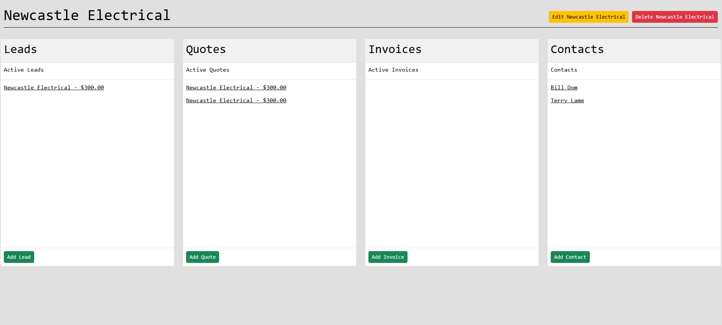
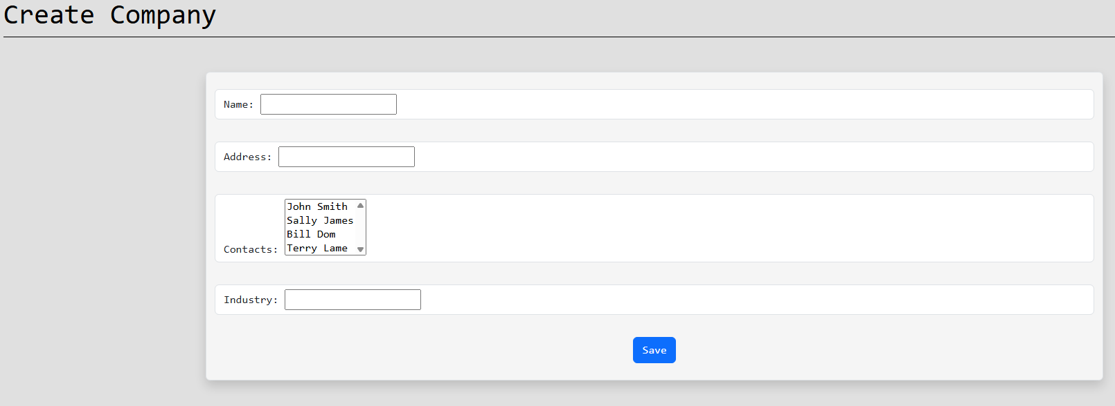
Companies
Notes:
Companies
Everything connects back to Companies
Company stores key info like name, contact details, industry, and notes
Leads and quotes are linked to companies using Django foreign keys
This makes it easy to view all leads, quotes, and interactions for a specific company
Strong company structure makes the app more organised and scalable

Slide 7
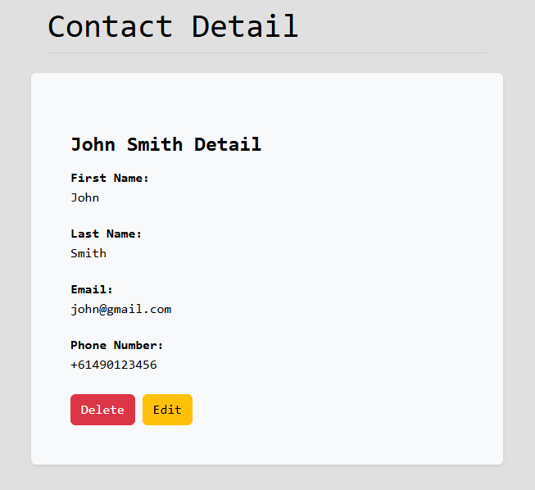
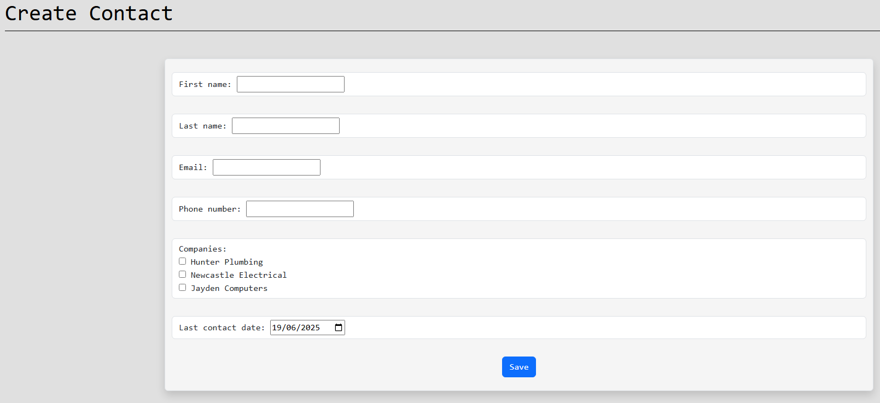
Contacts
Notes:
Contacts
Contacts represent individual people
Contacts can be linked to many companies
Each contact stores details like name, phone number and email
They can be assigned to leads, quotes or invoices to show who the point of contact is
Allows to keep track and reference individuals to companies

Slide 8
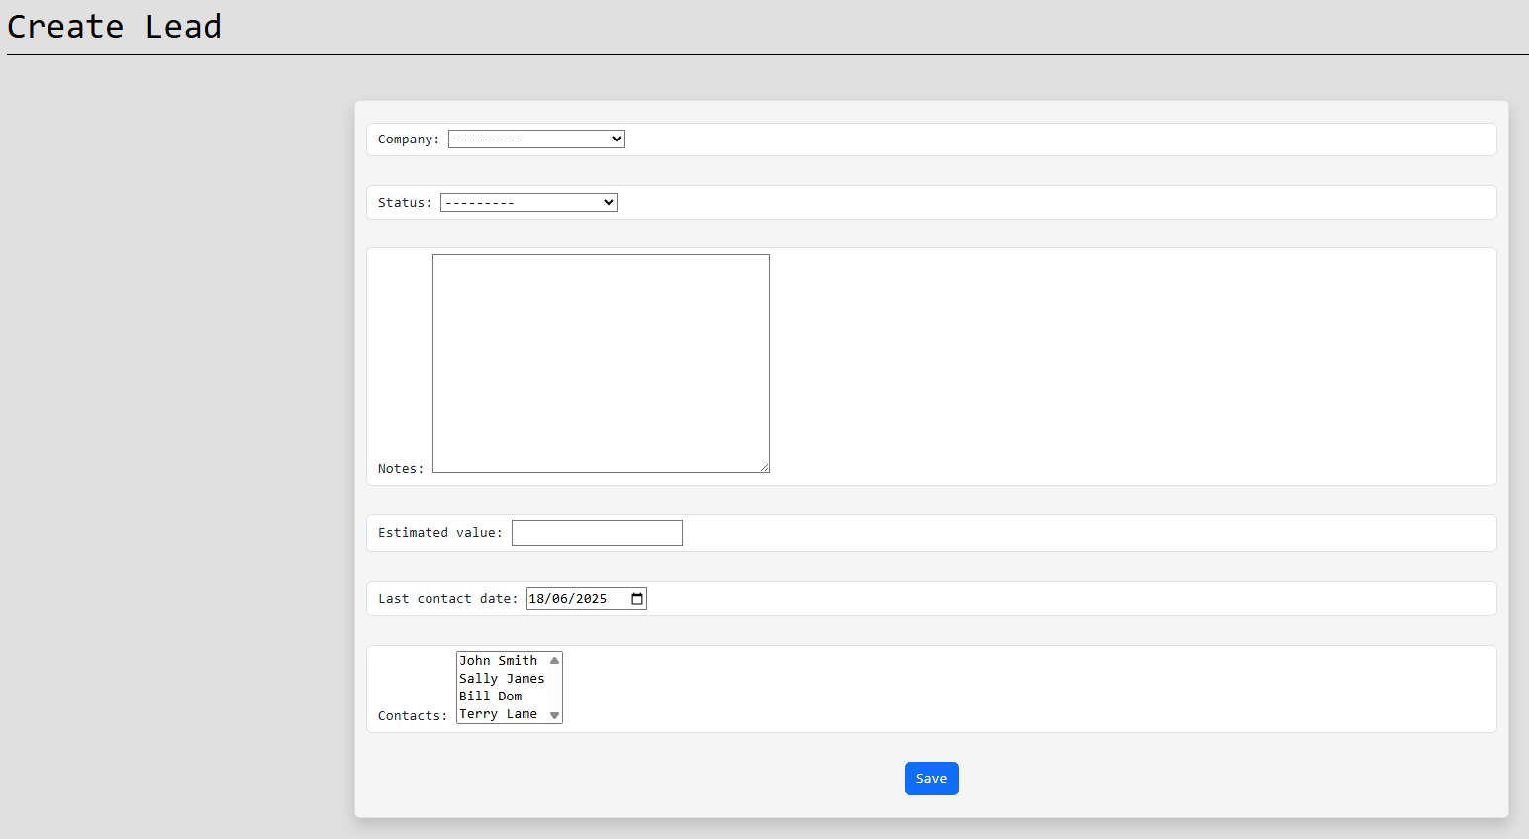
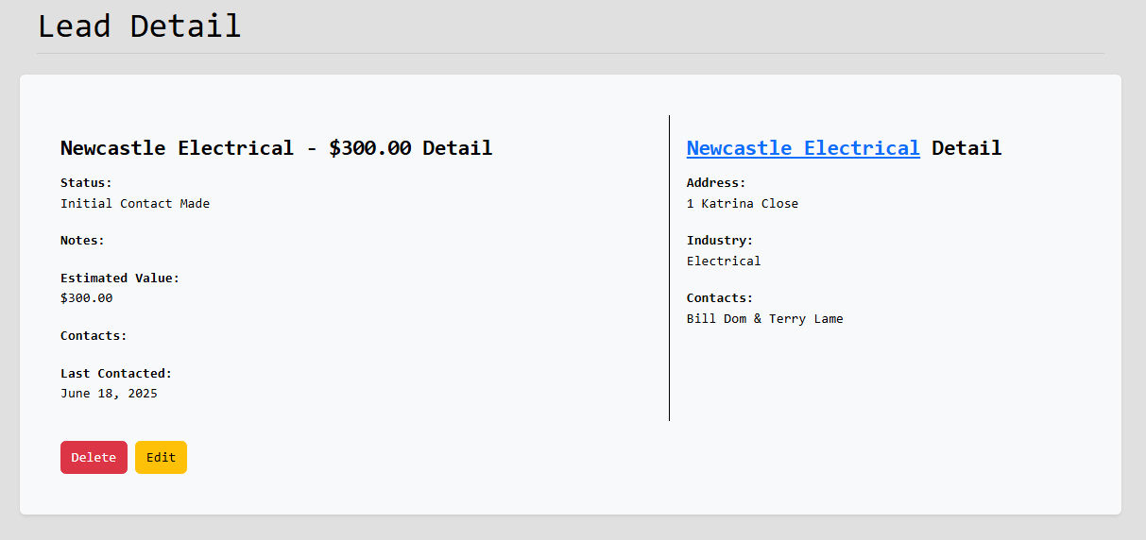
Leads
Notes:
Leads
They represent potential customers or clients who have shown interest but haven’t been converted yet
Lead in the system stores information such as their company, contact details, lead status, estimated price, last contacted and notes
Add, View, Update and Delete
Goal was to make lead tracking simple

Slide 9
Quotes
Notes:
Quotes
Quotes allow users to create detailed price offers to companies.
A quote is made up of multiple quote items – these are the individual products or services
Each quote item includes a description and a price
The total value of a quote is automatically calculated from the item prices
Quotes are linked to a company to stay organized
Quotes also have the option to be exported into a pdf

Slide 10
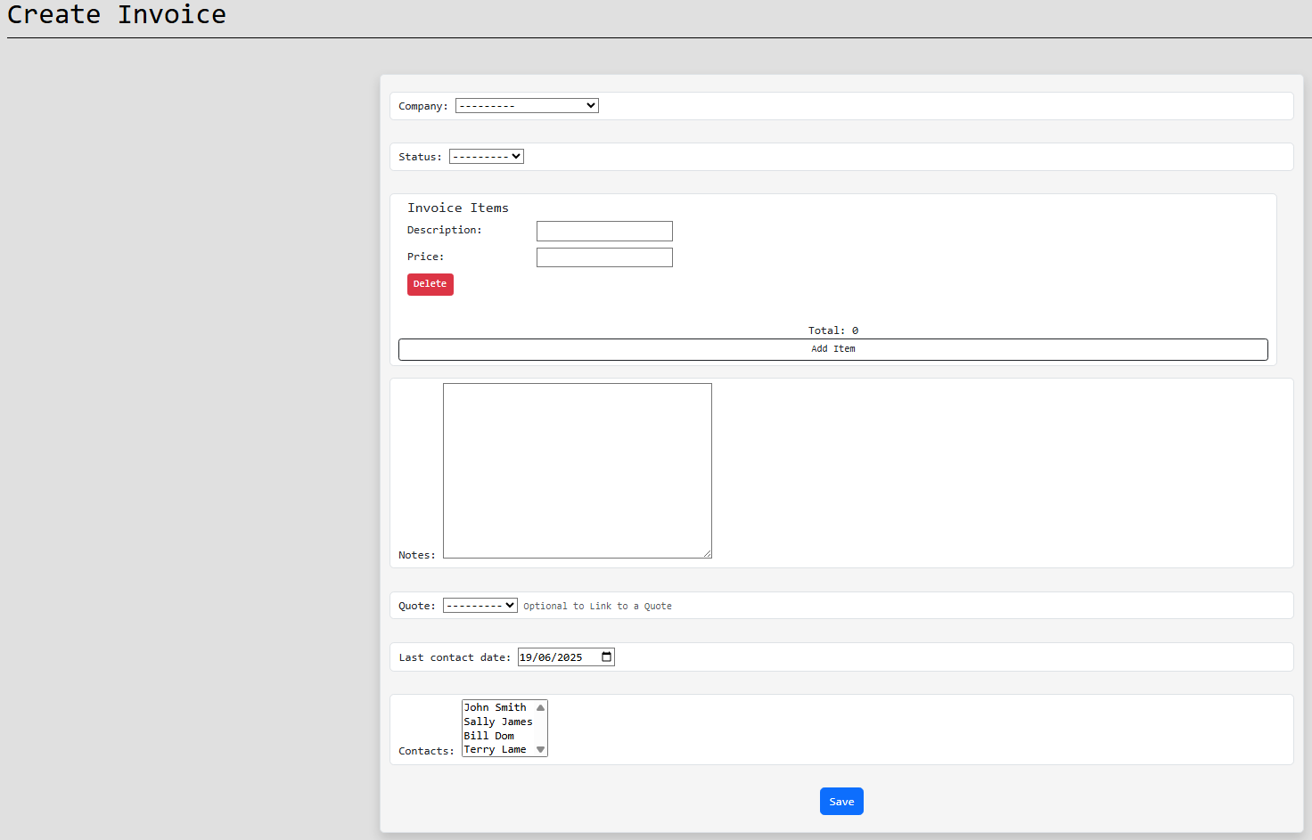
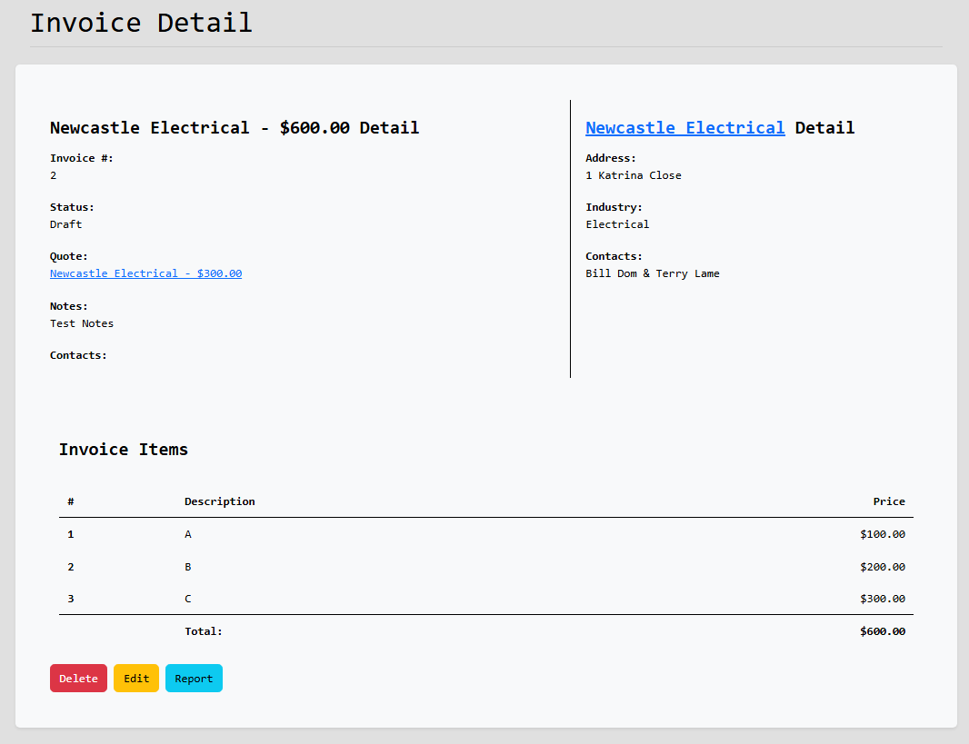
Invoices
Notes:
Invoices
Invoices allow users to create detailed price offers to companies.
An invoice is made up of multiple invoice items – these are the individual products or services
Each invoice item includes a description and a price
The total value of a invoice is automatically calculated from the item prices
Invoices are linked to a company and also can be linked to a quote to stay organized
Both invoice and quote are very similar, and I ended up using the same structure to create both of them
Invoices also have the option to be exported into a pdf

Slide 11
Firm’s Leads/Quotes/Invoices/Companies/Contacts
Notes:
Firms Views
These links in the navigation bar show all the corresponding items in the firm
This allows easy access to any item you need

Slide 12
Reporting

Slide 13
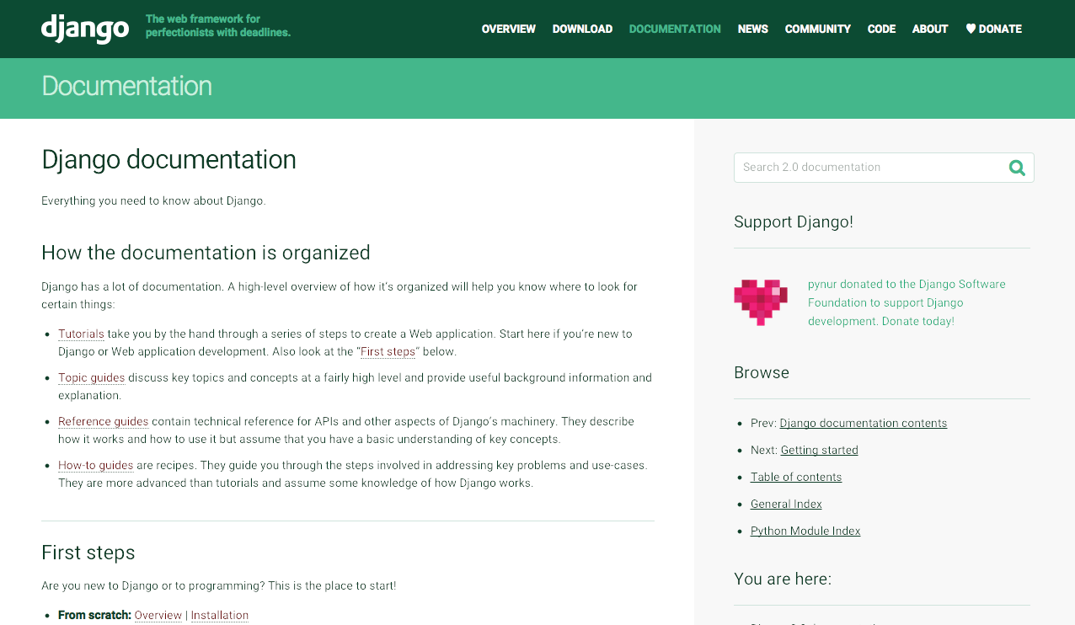
How did I make the App?
Notes:
How did I make the App?
Django, which is a powerful web framework for Python
Quickly set up the core functionality of the app
Features:
Admin panel
Authentication system
URL routing
Security
Started by designing Models – SQL Tables
Views to handle user interactions and connect them with the models
HTML templates and used Bootstrap
Implemented permissions and user roles
Forms and Formsets to create and edit data

Slide 14
Django Models
Notes:
Django Models
Django models define the structure of your database using Python classes.
Each model maps to a database table automatically.
Django’s ORM (Object-Relational Mapper) lets you interact with the database using Python instead of SQL.
Models are reusable, secure, and easy to update
Custom methods inside models can be added for extra logic like calculating totals or formatting a string
An example of a model would be this **Show Model**

Slide 15
Django Model Forms
Notes:
Django Model Forms
Django Model Forms automatically create forms based on your models.
They save time by generating input fields that match the model fields.
Validation and saving data to the database is handled automatically
Easily customize the layout, labels, widgets, and validation rules
Calling .save() on a form updates or creates a model instance
Helps keep your code clean and removes repeated code
An example of a model form would be this **Show Model Form**

Slide 16
Django Model FormSet
Notes:
Django Model Formset
A Django formset is a group of multiple forms managed together as one
They’re useful when you need to add, edit, or delete multiple items at once like quote items or invoice lines.
They handle form validation, ordering, and deletion for multiple forms at once
This helped me build flexible features like quotes with multiple line items in my CRM
An example of a model formset would be this **Show Model FormSet**

Slide 17
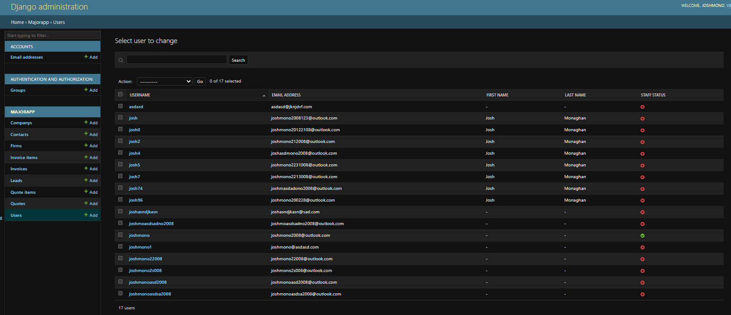
Legal Implications
Notes:
Legal Implications
Storing contact, lead, and company information means the app must follow privacy laws like the Australian Privacy Act or GDPR
Security Measures: When storing sensitive data, it's important to use protection techniques like, access controls, authentication and secure hosting
All data is being stored on the CRM databases which is data ownership issue, this means if I misuses data or share data without permission legal applications could occur
Invoices and quotes may be considered legal documents, so they must be accurate and securely stored.
Any external tools like Bootstrap or WeasyPrint must be used under proper open-source licenses.

Slide 18
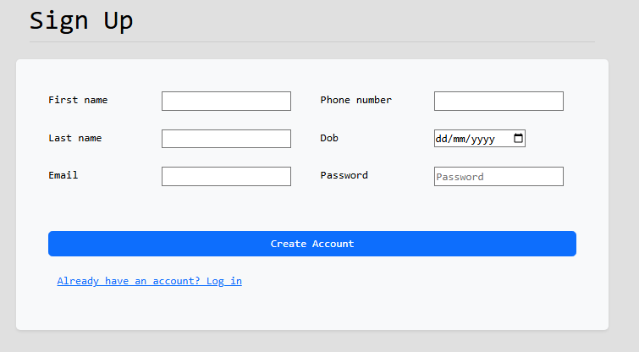
Ethical Implications
Notes:
Ethical Implications
It’s important to only collect what’s necessary and avoid storing sensitive info without consent
Ethically, the app should help users keep customer and lead information accurate and up to date
I have a duty to protect user data through secure coding practices and access controls.
The CRM should not be used to spam, mislead, or pressure leads and clients
App is usable by everyone, including people with disabilities.

Slide 19
Social Implications

